Slide 1
Orientation on Dissertation
M.Tech.
Dr. Sugata Ghosal
CSIS WILPD

Slide 2
Dissertation (SS/CSI/CC/SE)
Course Objective
Operation of the course
Identification of the dissertation topic and supervisor
Preparation of detailed outline of dissertation work in consultation with supervisor
Literature Survey
Objective, background of previous work in the area, methodology, and plan of work
Evaluation of dissertation outline by the examiner
Mid- Sem report - viva
End- Sem report and seminar - viva
Regular interaction with the supervisor

Slide 3
Dissertation (SS/CSI)
General Guidelines for student:
Duration of dissertation : 1 semester
Work should be presentable to external examiner
Measurable outcome
treated as full-time students and full-time employees
General guidelines for supervisor
Need to go through the Dissertation Handout carefully to understand the scope, objectives and methodology of a Dissertation
Guide and evaluate progress on regular basis
Should ensure high quality work
responsible for the periodic evaluation of the dissertation and submission of the completed evaluation forms

Slide 4
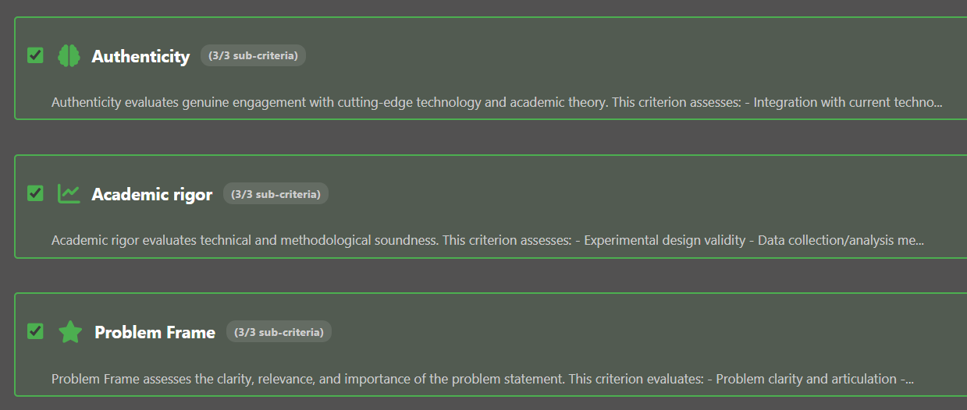
Quality of Dissertation (1)

Slide 5
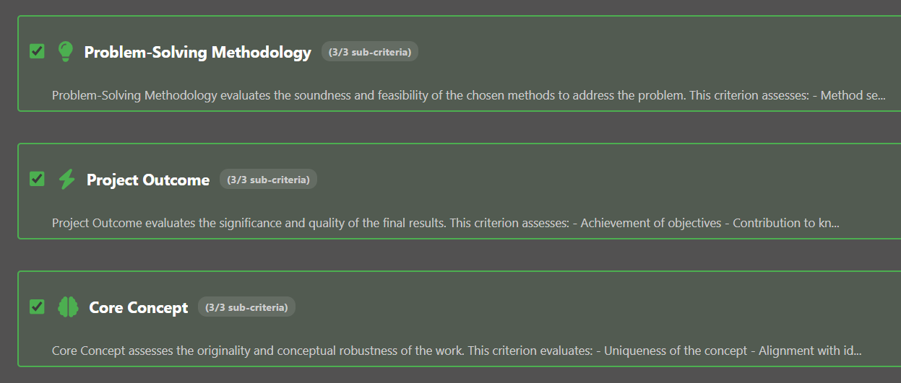
Quality of Dissertation (2)

Slide 6
Good Luck!
Thank You

